Slide 1


EPS Week 1

Slide 2



Introduction
The steering system of a car consists of a mechanism for rotating the front wheels of the car about an axis that is nearly vertical in response to steering wheel angle changes.

Slide 3

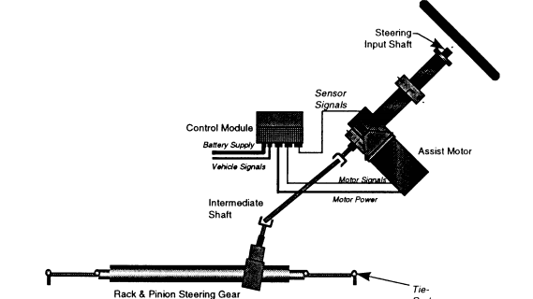
Notes:
(Modeling and Analysis of an Electric Power Steering System)

Slide 4
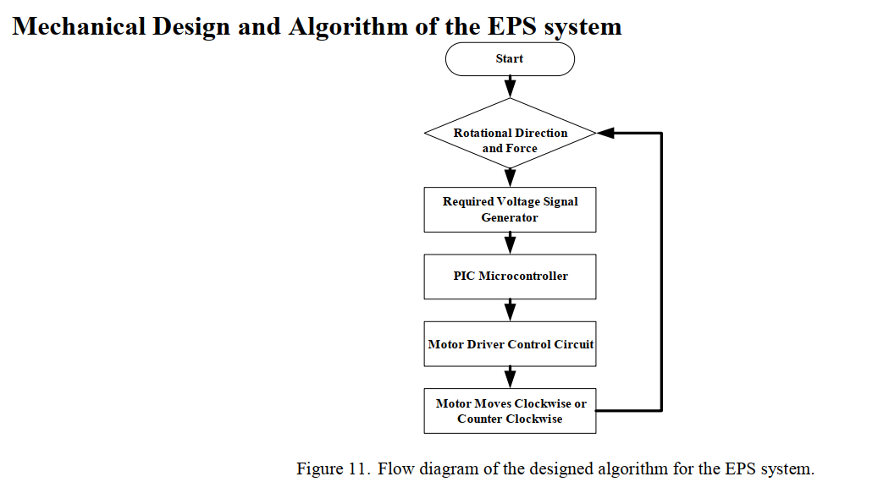

Notes:
(Journal _2011_AMM)
Hướng lái và lực
Phát ra tín hiệu điện theo mức yêu cầu
Đến Vi xử lý PIC
Dẫn đến tín hiệu điều khiển động cơ
Điều khiển động cơ qua trái hoặc qua phải để phù hợp -> check lại từ đầu

Slide 5
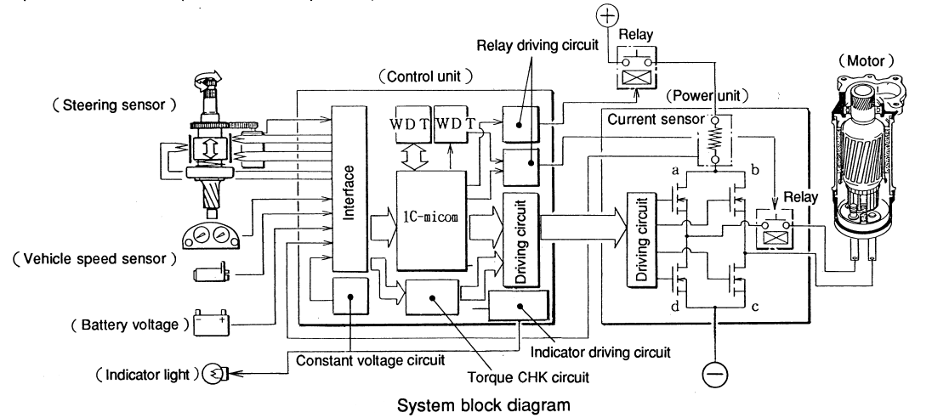
Notes:
(Development of EPS)

Slide 6

The steering sensor detects steering condition, and consists of a torque sensor, which senses rotation torque of a steering wheel, and a rotation speed sensor, which senses rotation speed of the steering wheel

Slide 8
Control unit can call instantaneously data from the predetermined data table based upon signals from various sensors so that the control unit can calculate those data to obtain the optimum assist force (motor assist torque data)

Slide 9
The power unit drives the motor based on instruction from the control unit. The current at that time is monitored by the control unit via the current sensor and if an abnormal condition is found, the relay shuts off motor current.

Slide 11
The vehicle speed sensor senses vehicle speed and issues pulse rows with frequency proportional to the vehicle speed to the control unit. Two vehicle speed sensors are used to diagnose failure of

Slide 12
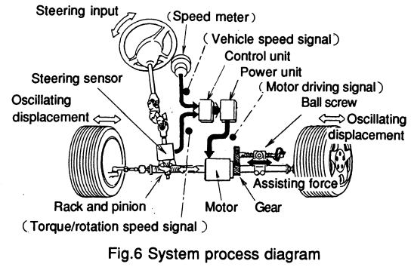
Operation description
As Fig. 6 shows, assisting operation (shown with black arrows) is added to manual steering (shown with white arrows) to reduce steering effort.

Slide 13
Assisting operation
Steering wheel input (torque and speed) is sensed by the steering sensor and signal is issued to the control unit.
The control unit receives the signals along with vehicle speed signal from the vehicle speed sensor.
The unit determines assisting force from predetermined table so that the optimum steering characteristics can be obtained and calculates output data.
At the same time, the unit detects steering condition based on signals from various sensors and decided modes (normal, return and damper).
The output data and the modes switching signals are output to the power unit.
The power unit drives the motor based on those signals.
Motor torque generated is transmitted to the ball screw via the gear.
Then, motor torque is converted smoothly and efficiently through the ball screw to assisting force working along axis of the rack shaft.
As a result, the thrust acts on the rack shaft and reduce another thrust obtained by the rack and pinion mechanism as mentioned above, i.e., the thrust generated by the motor is fed back to the steering sensor to reduce driver's effort on the steering wheel.

